Slide 1




B.TECH TITLE DEFENSE PRESENTATION 2020-21
To Minimize the Energy Consumption for Communication Protocol using IOT.
Project ID:21116
National Institute of Science & Technology
By
Suman Priya Sahu
Manisha Panda
Roll No: CSE- 201711357
Roll No: CSE-201741413
Under the guidance of
MR. RABINDRA KUMAR SHIAL
Suman Priya Sahu CSE-201711357 & Manisha Panda CSE- 201741413
[1]

Slide 2
B.TECH TITLE DEFENSE PRESENTATION 2020-21
CONTENT
Introduction
Objective
Methodology
Outcomes
Advantages
Conclusion
Reference
National Institute of Science & Technology
Suman Priya Sahu CSE-201711357 & Manisha Panda CSE- 201741413
[2]

Slide 3
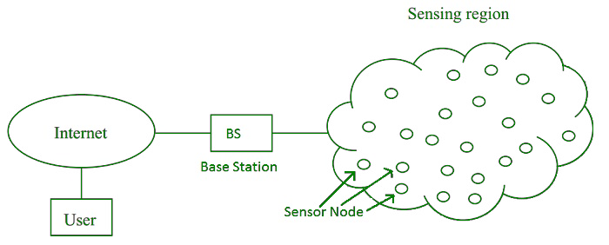
INTRODUCTION
B.TECH TITLE DEFENSE PRESENTATION 2020-21
A Wireless sensor network can be defined as a network of devices that can communicate the information gathered from a monitored field through wireless links.
A sink or a base station acts like an interface between users and the network,
One can retrieve information from the network by gathering results from the sink
A wireless sensor network contains thousands of sensor nodes which are being communicated by using radio signals.
National Institute of Science & Technology
Suman Priya Sahu CSE-201711357 & Manisha Panda CSE- 201741413
[3]

Slide 4
OBJECTIVE
B.TECH TITLE DEFENSE PRESENTATION 2020-21
Our goal for this project was to use Advance Technology of Wireless Sensor Network in order to develop,analyse and to minimize the energy consumption for communication protocol in IOT application.
As per the requirement a proper balance between communication and signal/data processing capabilities should be maintained.
Once we get a good fit ,we will use LEACH Protocol to reduced energy consumption by each network sensor node.
National Institute of Science & Technology
Suman Priya Sahu CSE-201711357 & Manisha Panda CSE- 201741413
[4]

Slide 5
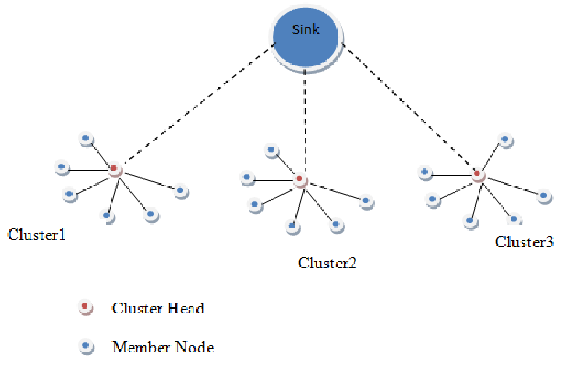
METHODOLOGY
B.TECH TITLE DEFENSE PRESENTATION 2020-21
Here LEACH protocol is modified by using threshold for cluster selection. At the same time it will maintain the power level of the nodes. Node will be deployed, distance among the node will be calculated, cluster will be created and the energy consume from each node will calculated. The project will be implementing in NS2.
National Institute of Science & Technology
Suman Priya Sahu CSE-201711357 & Manisha Panda CSE- 201741413
[5]

Slide 6
OUTCOMES
B.TECH TITLE DEFENSE PRESENTATION 2020-21
After calculating the distance among the nodes and energy consume by each node, all the non cluster head nodes transmit data to their cluster head.
The sensing area is then partition into zones subsequently from each zone cluster head is randomly selected.
The cluster head rotation is perform by determining the nearest node that has maximum residual energy. This perform many rounds to minimise the communication overhead.
After calculating the randomized rotation of cluster heads among the sensors
Cluster Head receives this data and perform signal processing functions on the data and transmits data to the base station.
National Institute of Science & Technology
Suman Priya Sahu CSE-201711357 & Manisha Panda CSE- 201741413
[6]

Slide 7
ADVANTAGE
B.TECH TITLE DEFENSE PRESENTATION 2020-21
Communication protocols enables the object to be sensed and also control it remotely, resulting better interaction of physical world with computers.
This project is also appropriate for modeling in low-cost and with low-complexity solutions.
The proposed communication protocol performs better in terms of stability period and network lifetime in different scenarios of area, energy and node density.
National Institute of Science & Technology
Suman Priya Sahu CSE-201711357 & Manisha Panda CSE- 201741413
[7]

Slide 8
CONCLUSION
B.TECH TITLE DEFENSE PRESENTATION 2020-21
Hence we conclude that we have used a different approach to promote highly effective communication protocol.
When compared with other energy efficient protocols, it is found that the proposed algorithm performs better in terms of stability period and network lifetime in different scenarios of area, energy and node density.
National Institute of Science & Technology
Suman Priya Sahu CSE-201711357 & Manisha Panda CSE- 201741413
[8]

Slide 9
REFERENCE
B.TECH TITLE DEFENSE PRESENTATION 2020-21
R.P. Mahapatra and R.K. Yadav, "Descendant of LEACH based routing protocols in wireless sensor networks", Procedia Comput. Sci., vol. 57, pp. 1005-1014, 2015.
L. Yadav and C. Sunitha, "Low energy adaptive clustering hierarchy in wireless sensor network (LEACH)", Int. J. Comput. Sci. Inf. Technol., vol. 5, no. 3, pp. 4661-4664, 2014.
National Institute of Science & Technology
Suman Priya Sahu CSE-201711357 & Manisha Panda CSE- 201741413
[9]

Slide 10
THANK YOU
B.TECH TITLE DEFENSE PRESENTATION 2020-21
National Institute of Science & Technology
Suman Priya Sahu CSE-201711357 & Manisha Panda CSE- 201741413
[10]

